Slide 1

A Fake News Detection And Verification Tool
What:
Process of verifying the veracity of information to determine if it is authentic or intentionally fabricated misinformation.
Why:
The rapid expansion of digital news has led to a significant increase in fake news, which can influence public opinion, harm reputations, and impact social stability. Traditional manual fact-checking is time-consuming and not scalable.

Slide 2
The Problem: Unverified News and Rapid Misinformation
In today's digital era, users often consume news without verifying its authenticity. This lack of an easy-to-use verification system leads to the rapid spread of misinformation.
Manual Verification Challenges
Misinformation Spread
Lack of Centralized Tools
The rapid and uncontrolled dissemination of false information across platforms.
Absence of user-friendly and centralized platforms for fake news detection.
Difficulty in identifying fake news manually due to the sheer volume of content.

Slide 3
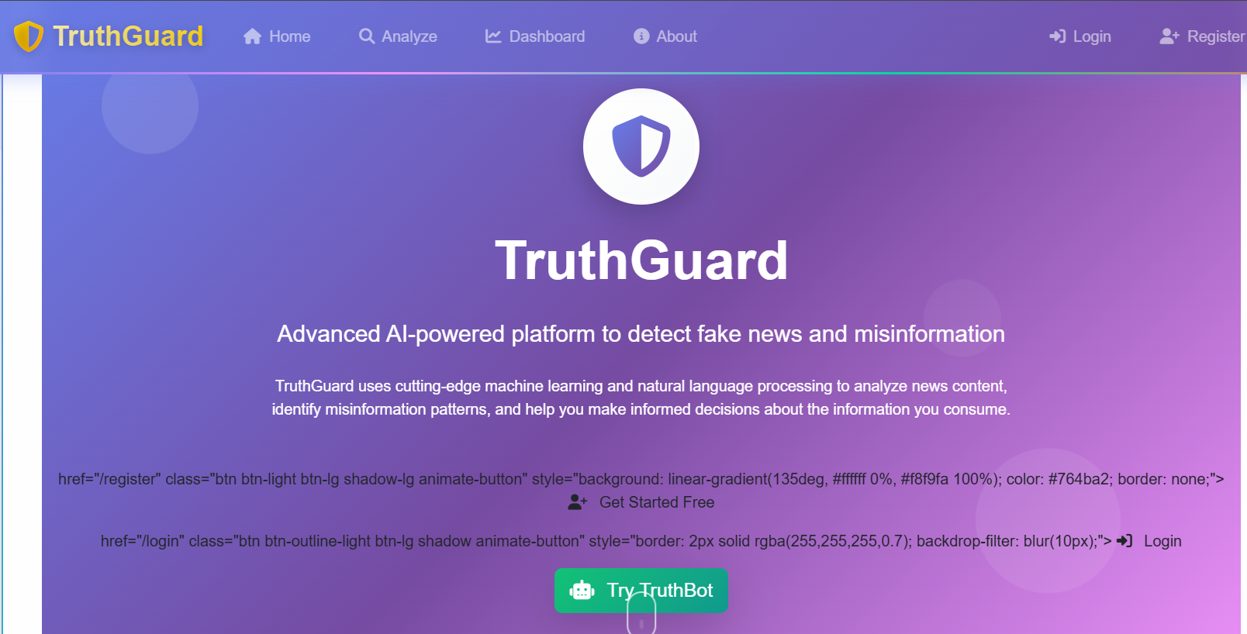
Project Objectives: Building a Reliable Detection System
Our project aims to address the challenges of fake news by developing a comprehensive, web-based detection system.
Web-Based Design
1
To design a user-friendly web-based fake news detection system.
ML Classification
2
To classify news content as fake or real using machine learning techniques.
Secure Authentication
3
To provide a secure user authentication system for controlled access.
Analysis History
4
To store and display a history of all news analyses performed by users.
Admin Monitoring
5
To provide an admin panel for monitoring users and analysis data.

Slide 4

System Overview: A Flask-Based Web Application
The Fake News Detection System is implemented as a Flask web application, offering an intuitive interface for users and robust backend processing.
Users interact through HTML-based frontend pages. The backend processes input, performs fake news classification using machine learning, and stores results. An admin module allows for system monitoring.
Text-based news analysis
Accessible via web browser
Suitable for students, researchers, and general users
Extensible for multiple languages and media types

Slide 5

Technologies Powering the System
Our system leverages a modern tech stack to ensure efficiency, scalability, and ease of development.
Software Requirements
Libraries and Tools
Programming Language: Python
Flask: Web application framework
Web Framework: Flask
Machine Learning Libraries: For fake news classification
Frontend: HTML, CSS
Version Control: GitHub
Logging Utilities: For system monitoring and debugging

Slide 6
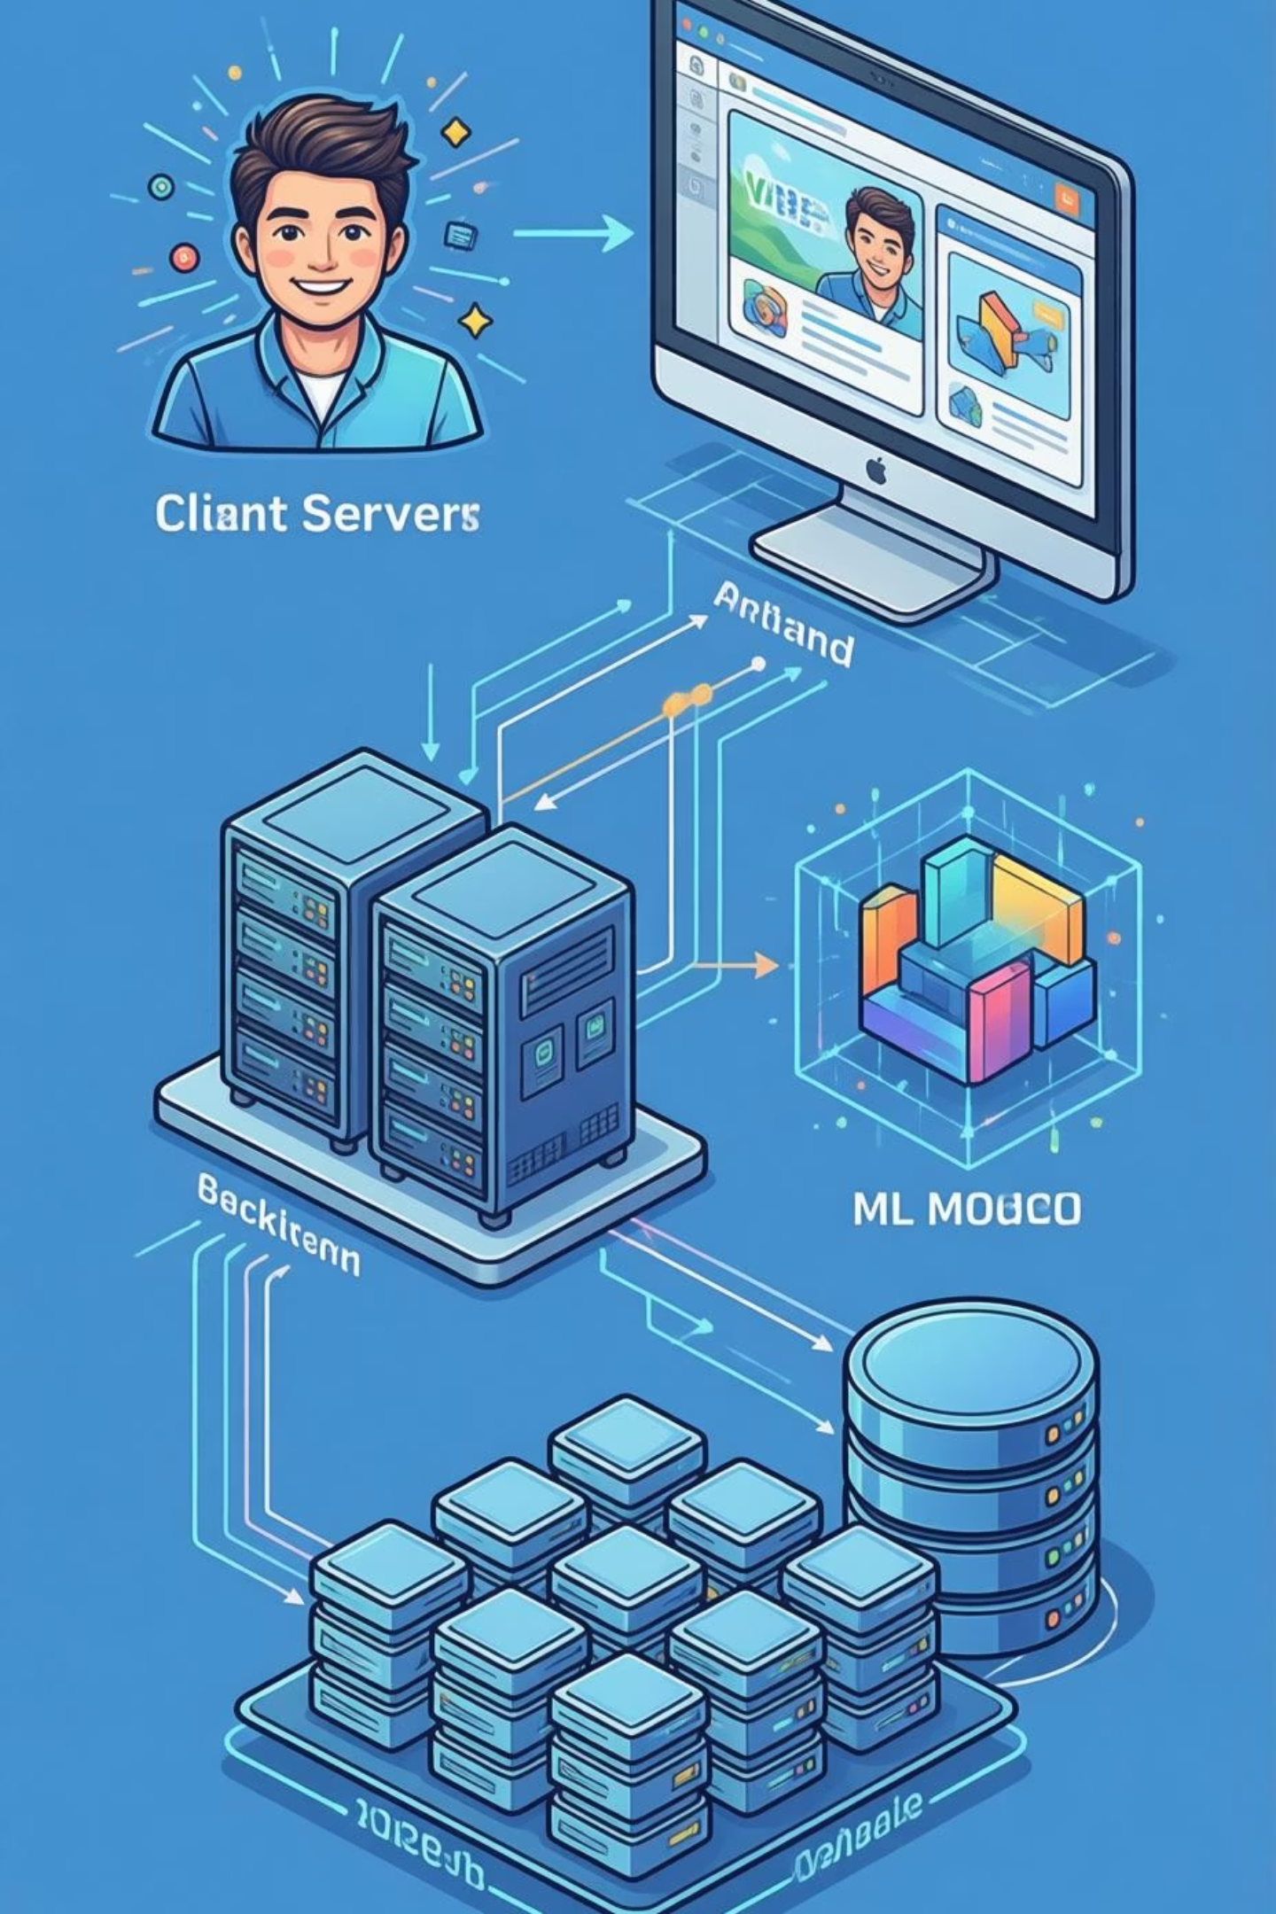
System Architecture: Client-Server Model
The Fake News Detection System employs a client-server architecture, separating concerns for modularity, scalability, and ease of maintenance.
The architecture ensures a clear flow from user interaction to data processing and storage, with distinct modules for each function.

Slide 7
AnalysisId, UserId (Foreign Key), Input Text, Result (Fake/Real), Confidence Score, and Timestamp.
Database Schema
The database architecture consists of three primary table that capture user information ,Analysis result and Logs table. System utilizes a relational structure to manage data:
User Table: Fields for UserId, Username, Email, and Password Hash.
Stores authentication user account with secure password hashing.
Analysis Table: Fields for AnalysisId, UserId (Foreign Key), Input Text, Result (Fake/Real), Confidence Score, and Timestamp.
Maintains comprehensive records of all verification request and results.
Logs Table: Fields for LogId, Event Description, and Date-Time.
Tracks account creation date and login ,history for security and user engagement analysis.
Analysis
User
Logs
Fields for UserId, Username, Email, and Password Hash.
Fields for LogId, Event Description, and Date-Time.

Slide 8







Architecture Flow: From Input to Insight
The system's workflow is designed for seamless interaction and efficient news classification.
User Access
User accesses the system via a web browser.
Input Collection
Frontend (HTML) collects news text input.
Backend Processing
Flask backend handles requests and business logic.
ML Model Prediction
News text is processed and classified as fake or real by the ML model.
Result Display
Classification result is returned to the frontend and displayed.
Data Storage
Analysis result is stored in the system database.
Admin Monitoring
Admin users view details, analyses, and logs via the admin panel.

Slide 9





Key Modules: Functionality at a Glance
The system is divided into distinct modules, each responsible for specific functionalities,
enhancing maintainability and clarity.
User Module
News Analysis Module
Analysis History Module
Manages registration, secure login, and profile management for authenticated access.
Accepts text input, preprocesses, and passes to ML model for classification.
Stores and displays past analysis results for transparency and reference.
Admin Module
Logging Module
Provides administrative control, including user and analysis monitoring.
Records system activities and events for debugging and reliability.

Slide 10

Advantages and Limitations
Our system offers significant benefits while acknowledging current limitations and future potential.
Advantages
Limitations
User-friendly web interface
Currently limited to text-based news
Automated fake news detection
Secure authentication system
Accuracy depends on training data quality
Admin monitoring facility
Scalable and extensible architecture
Does not analyze images or videos

Slide 11

Future Enhancements
The Fake News Detection System is a robust solution with exciting potential for future growth.
Future Enhancements
Integration of deep learning models
Multi-language support for broader reach
Image and video fake news detection
Development of a mobile application

Slide 12
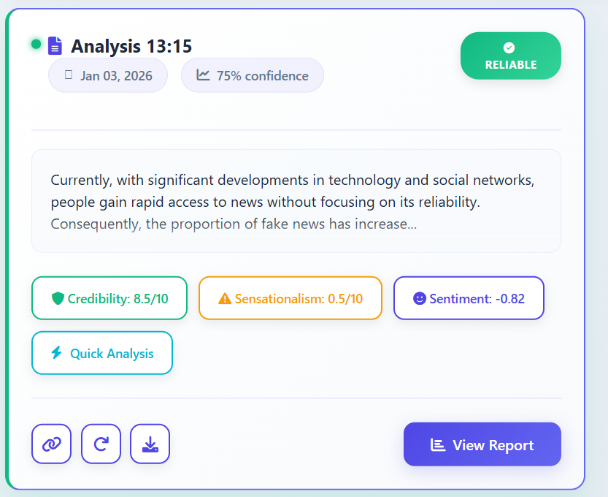
When a user submits text for verification, the system generates a result card:
Status: Reliable / Fake News.
Credibility: 8.5/10.
Confidence: 75%.
Sentiment: -0.82 (indicates negative/deceptive tone).
Sample Output

Slide 13

Conclusion
This system successfully integrates with a Flask web application to efficiently detect fake news. It provides a user-friendly and scalable solution to combat misinformation, with a clear path for comprehensive news verification.

Slide 14
Thank You!

